Slide 1
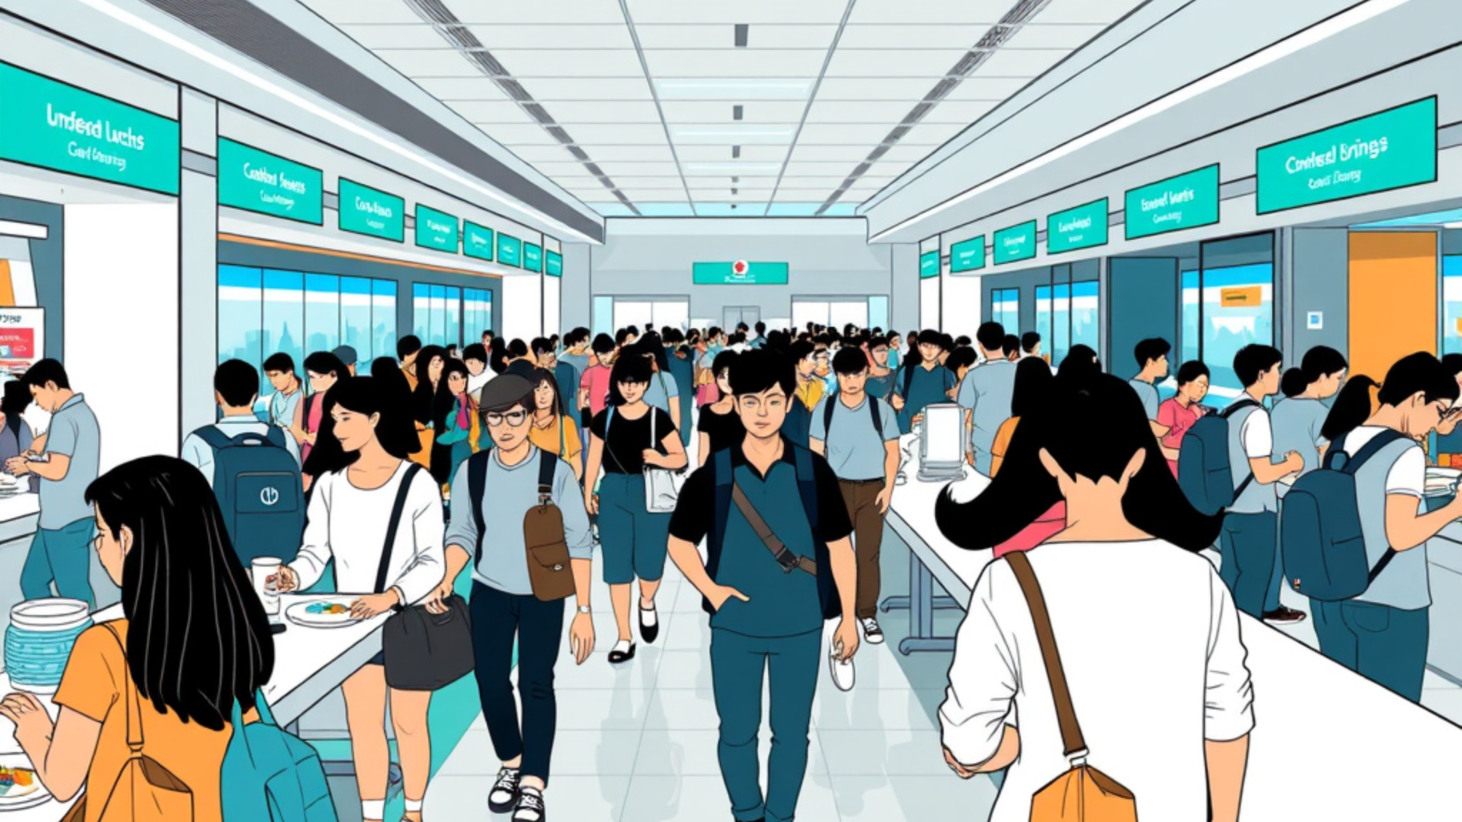
CAMPUS DINING, REIMAGINED
Smart Canteen Queue
& Order Management
Efficiency-focused campus dining made faster, simpler, and more predictable.

Slide 2






SMART CANTEEN
Presentation Agenda
From today’s queue friction to a smoother student pickup experience.
Current canteen challenges
Where waiting, crowding, and uncertainty slow the lunch rush.
The destination
A faster, clearer experience for students and canteen teams.
Smart queue solution
A digital approach to organizing orders before students arrive.
Order and pickup workflow
Follow the streamlined path from selection to collection.
NEXT
See how it works

Slide 3



THE DAILY FRICTION
Why traditional canteens feel slow
Small delays compound into a difficult break between classes.
Long queues waste student time
Every minute waiting is a minute lost between classes.
Peak hours create crowding
Congestion turns a simple meal into a stressful rush.
Manual ordering makes waiting unpredictable
Mistakes and unclear wait times make planning difficult.
The problem is not lunch — it is the waiting experience.

Slide 4






SMART CAMPUS SERVICE
What Smart Queue Management Does
A streamlined digital flow helps students enter, track, and move through campus services with less friction.
Join Digitally
Track Your Turn
Balance Service Flow
Enter the queue through a digital token or QR code—no physical line required.
See real-time order status and waiting updates while staying informed.
Route demand more intelligently across counters for a faster, more organized student experience.
Simple check-in
Clear visibility
Smoother student flow

Slide 5









SMART CAMPUS DINING
How the Ordering Process Works
From waiting in line to a clear, connected pickup journey.
Old flow
Smart flow
Manual and uncertain
Order, prepare, collect
Students join a physical queue
Students order at a kiosk or in the app
Orders are checked at the counter
The system confirms items and pickup time
Pickup timing stays unclear
Kitchen prepares instantly; students collect when called
The smart flow turns every order into a visible, predictable handoff.

Slide 6
STUDENT EXPERIENCE · IMPACT
Efficiency gains for students
A smoother campus meal flow gives students back the time and certainty they need.
THE PAYOFF
WHAT CHANGES IN THE DAY
More time
01
Faster decisions
Better meal planning during busy schedules.
02
Fewer missed meals
Less waiting means more time for classes, study, and the rest of campus life.
Fewer abandoned queues and missed meals.
03
Predictable peaks
More predictable service during peak hours.

Slide 7









OPERATIONAL BENEFITS
Operational Benefits for the Canteen
A smoother service flow for students, kitchen teams, and front-line staff.
Reduced crowding
Faster service flow
Demand visibility
Less
Smoother
Clearer
Quicker movement through service counters
Better kitchen prioritization and staff coordination
More accurate demand tracking for daily planning

Slide 8








KEY TECHNOLOGY COMPONENTS
A smoother campus flow, end to end
Student-facing access points connect directly to the tools that keep service moving behind the scenes.
Student-facing tools
Back-end management
QR codes, kiosks, and mobile ordering make it easy to choose, pay, and move on.
Dashboards turn orders and inventory into a shared operating picture for teams.
Live queue displays and pickup alerts
Inventory and order tracking in one view
Clearer pathways from order to collection
Analytics support smarter busy-time planning

Slide 9









STUDENT EXPERIENCE
Student Experience Improvements
A smoother campus dining flow — less waiting, clearer updates, better pickup.
What students gain
Problems solved
A more convenient everyday routine
Friction removed from the dining journey
Less stress during lunch rush
Long, unpredictable lunch queues
Convenient ordering from anywhere on campus
Uncertainty about order status and timing
Unnecessary waiting at the pickup point
Faster pickup creates better dining satisfaction
The result: students spend less time managing lunch and more time enjoying campus.

Slide 10





ROLLOUT READINESS
Implementation Success Factors
Successful adoption depends on removing friction for students while giving staff the conditions to respond, improve, and sustain the new process.
The practical foundation
Make the first step effortless
Build the feedback loop in from day one.
An easy-to-use interface keeps every student moving with confidence.
Protect the learning environment
Listen to what students and staff experience, then use those signals to improve the next cycle.
Reliable internet and display infrastructure prevent avoidable pauses.
Equip the people behind the process
Staff training and process discipline turn a launch into a repeatable routine.
Ready to launch means ready to learn.

Slide 11



CONCLUSION
Faster Dining, Happier Students
The principle is simple
“Make every meal moment move better — so students can spend more time on what matters.”
Smart systems turn everyday convenience into student success.
Save time every day
Improve campus flow
Support student success
BETTER FLOW. BETTER DAYS.

